Slide 1

Random Intercept Models in R
Psych 741: Hierarchical Linear Modeling

Slide 2
Overview of Tutorial Slides
Creating group-aggregate variables (pages 3-7)
Random Intercept Multilevel Models
Overview of tutorial data (page 9)
Example Code (pages 10-12)
Example Output (pages 13-15)

Slide 3
Creating Group Aggregate Variables

Slide 4
Aggregate Variables in R
Lots of functions can be utilized to complete the two necessary steps:
Aggregate the variable based on group status to estimate the desired statistics (e.g., the group average/mean)
Apply these values back to the original data frame
In my experience, combining the group_by() and mutate() functions from the tidyverse is the easiest way

Slide 5
Example
Let’s use the lq2002.sav data file on Canvas since it already has some group-aggregate variables included in it
So, we can check at the end to make sure it worked correctly!
There are the individual ratings of the army individuals on the task significance (TSIG) and the army company average ratings of task significance (GTSIG).

Slide 6

Example Code
In this example, we group by company ID and estimate the mean individual ratings of task significance
We also mutate a column in the original data frame to contain these Level-2 average ratings of task significance

Slide 7
Checking Our Work
Let’s check our work in this example by correlating the GTSIG_check variable we created and the GTSIG variable already included in the data set.
Perfect correlation (woohoo!!)

Slide 8
Random Intercept Models

Slide 9
Tutorial Data
Using the lq2002.sav data file on Canvas
Sample of individual army members nested in army companies
Example from the Garson textbook
The following variables are included in the data set:
HOSTILE: Individual-level Hostility Scale score
TSIG: Individual-level Task Significance score
COMPID: Grouping variable
GTSIG: Company-level aggregate Task Significance score

Slide 10
Example Model and Code
Imagine the following research question:
“What is the effect of individual-level and company-level perception of task significance on mean individual-level feelings of hostility, adjusting for the clustering of hostility scale scores by army company?”

Slide 11

Example Model and Code
First, let’s perform a null multilevel model for subsequent comparison:
HOSTILE: the DV.
(1|COMPID): the random intercept.
REML = FALSE: the default in lmer() is to use restricted ML. Need to set this to false if you want to use ML.
lq2002: the dataframe name.

Slide 12
Example Model and Code
Second, let’s perform the random intercept model to test the research question:
Same as the null model, but with the following two additions:
TSIG: the Level 1 predictor of individual ratings of task significance.
GTSIG: the Level 2 predictor of company-level (average) ratings of task significance.

Slide 13
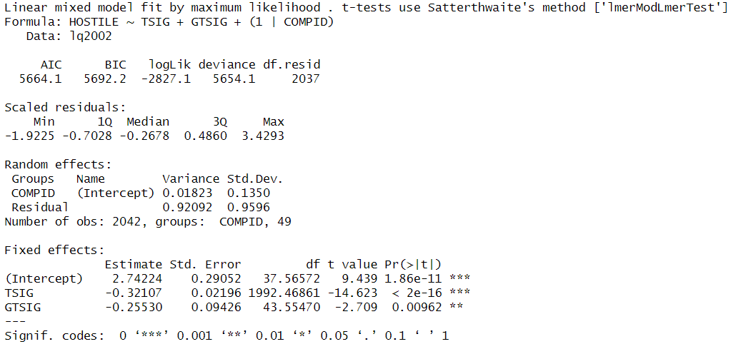

Example Output

Slide 14
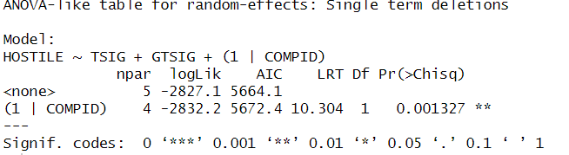
Getting p-values for random effects
Use the rand() function from the lmerTest package

Slide 15
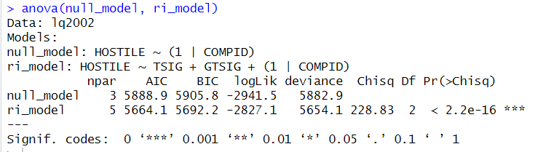
Likelihood ratio test
Use the anova() function to compare the null and random intercept models

